Slide 1
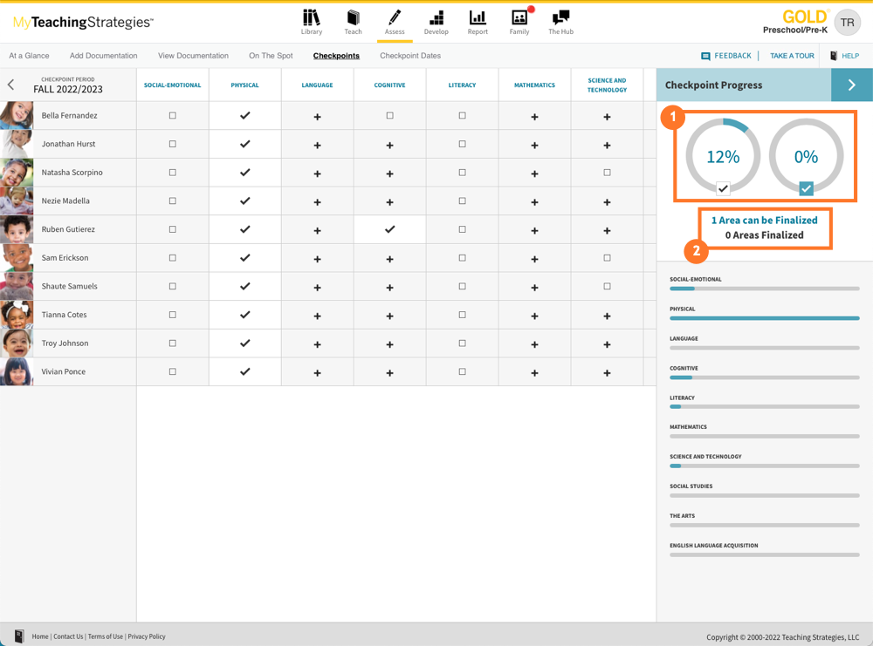
Teaching Strategies GOLD
Checkpoint
PLC- January 11th and 12
Ms. Tortora

Slide 3
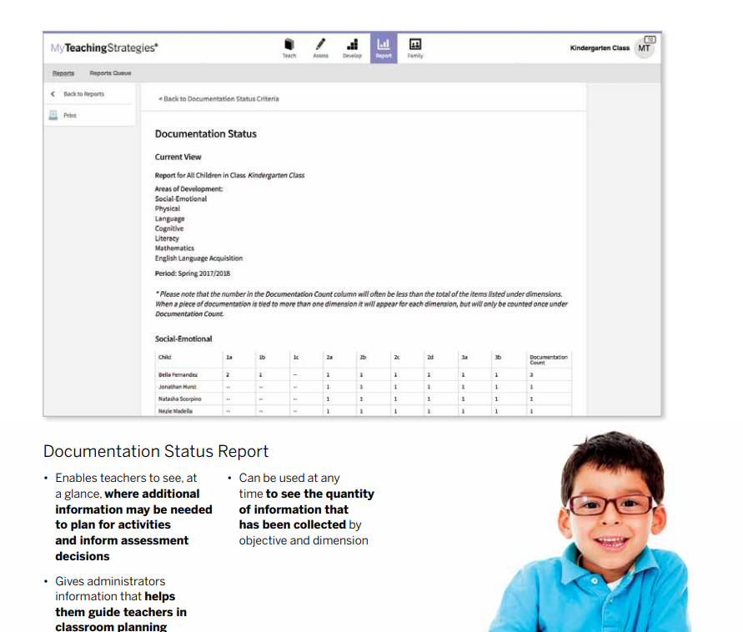
Which objectives might we need to focus on?

Slide 4
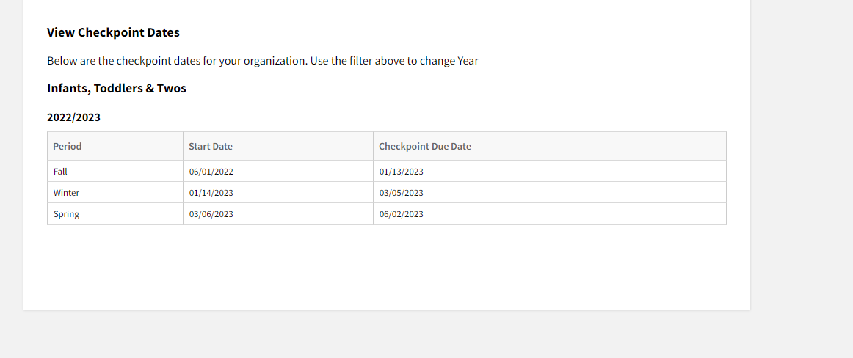
Checkpoint Dates

Slide 5
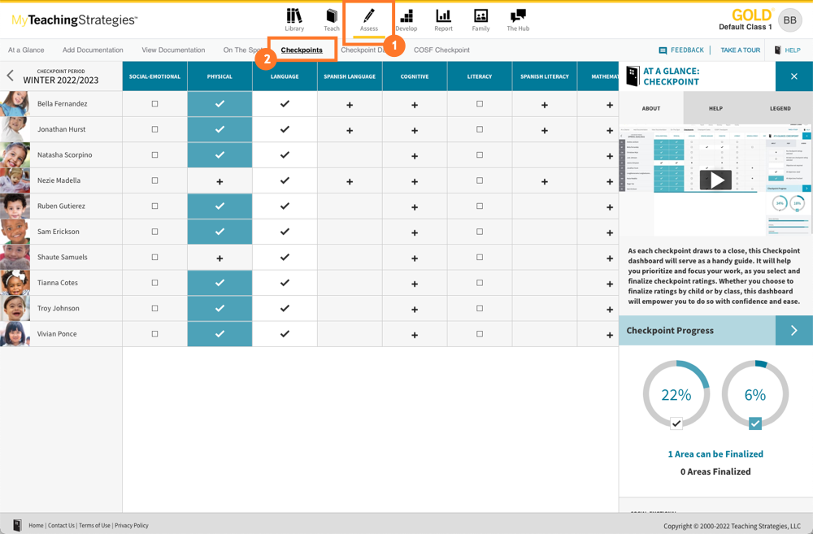
How to Locate the Checkpoints

Slide 6
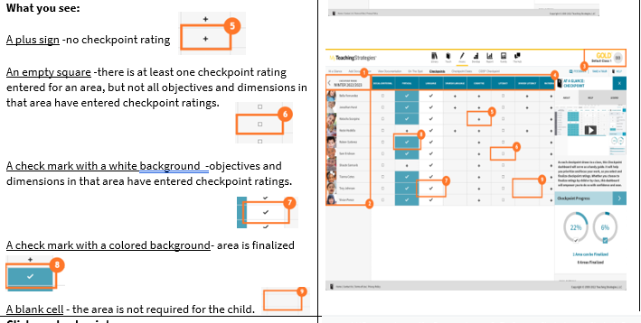

Slide 7
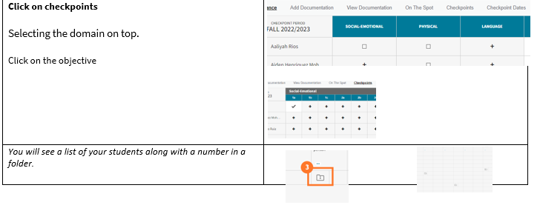
If you click on the folder you can view the documentation.
The number in the folder represents how many pieces of evidence you have for this objective.
The number on these folders represents the amount of documentation with a preliminary level of that corresponding level. For example, a folder with a "2" listed under Level 6 represents that you have two pieces of documentation for the child with Level 6 selected as the preliminary level.
Select one of these folders to view all of those documentation items.

Slide 10
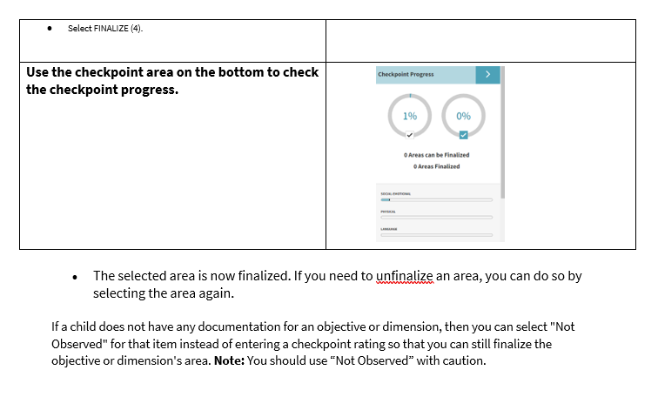

Slide 11
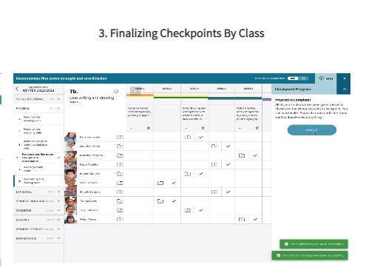
Resources
Select finalizing Checkpoints By Child/by class
https://teachingstrategies.force.com/portal/s/GOLD-ready-set-go-videos

